Slide 1
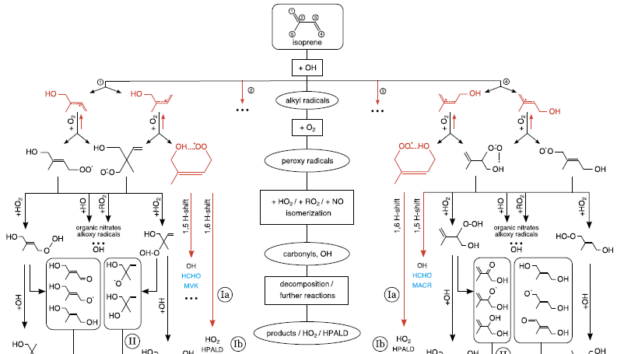
Atmospheric Chemistry
How reactions influence Our climate

Slide 2
Last Week Recap
Climate change is driven by the Greenhouse Effect
Increasing Earth surface temperatures drive ice cap melting and sea level rise
Warmer oceans increase storm and flooding frequency
Temperature changes will alter the global food supply
There are hundreds of thousands of greenhouse gases
H₂O, CO₂, F-gases, N₂O, Methane, and Ozone are the most important
Greenhouse gases absorb IR radiation and require changing dipoles to do so

Slide 3
Chemistry Refresher
Nothing is Ever quite as refreshing

Slide 4
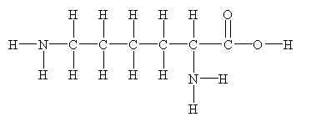
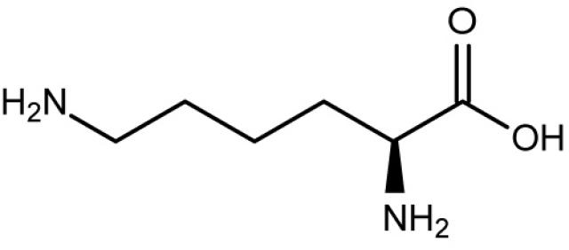
Important Elements
CHON
Carbon, hydrogen, oxygen, and nitrogen are the most prevalent elements in the atmosphere
Considered to be the major organic elements
=
Halogens
Chlorine and bromine are important for ozone destruction

Slide 5
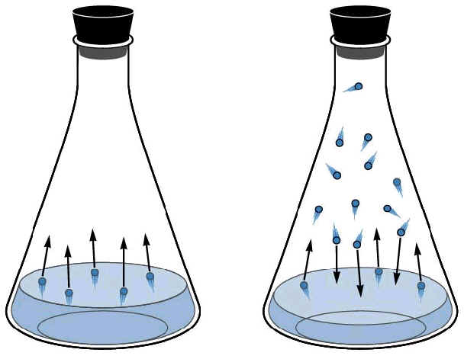
Volatility and Vapor Pressure
Vapor Pressure
The pressure that a vapor exerts at equilibrium over the surface of a liquid
Henry’s Law
Describes how the vapor pressure of a gas over a liquid is directly proportional to the concentration of the gas in that liquid
k = Henry’s Law Constant

Slide 6
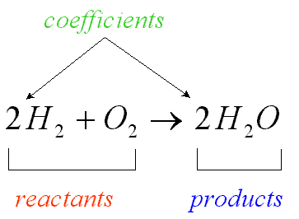
Chemical Reactions
Chemical reactions involve two or more molecules interacting to form molecules with new chemical and physical properties
Mass and energy are conserved throughout reactions
Kinetics: describe how fast reactions occur
Thermodynamics: describe whether a reaction will occur

Slide 7
Catalysts
Catalyst: a species that alters the rate of a chemical reaction but is ultimately neither created nor destroyed as a part of the reaction
Catalysts can either lower or raise the activation energy of a reaction
See board notes for more

Slide 8
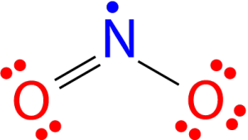
Radicals
The Octet Rule
Each atom in a molecule would like to have 8 electrons in its valence electron shell
Radicals are molecules and atoms that contain unpaired electrons
Radicals do not subscribe to the octet rule and are thus highly reactive

Slide 9
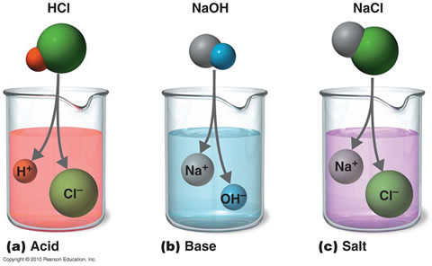
Acids and Bases
Acids: donate protons (hydrogen ions)
Sour
Bases: donate OH- (hydroxide ions)
Slippery and bitter
When acids and bases combine, they form water and salt.

Slide 10
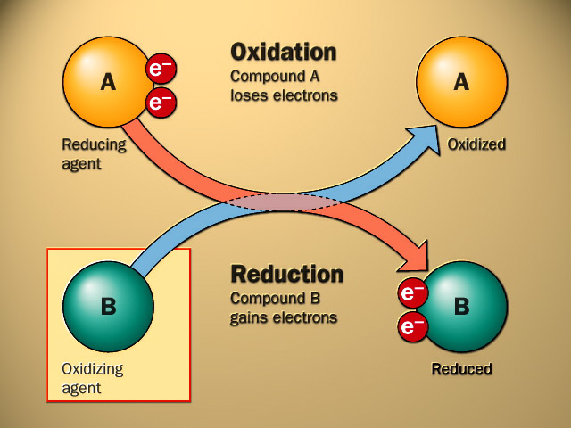
Oxidation and Reduction
OIL RIG
Oxidation Involves Loss, Reduction Involves Gain
Describes loss/gain of electrons
Electronegative elements tend to be oxidizing agents while hydrocarbons tend to get reduced

Slide 11
The Basics of Atmospheric Chemistry
Actually, the Atmosphere is Pretty Acidic

Slide 12
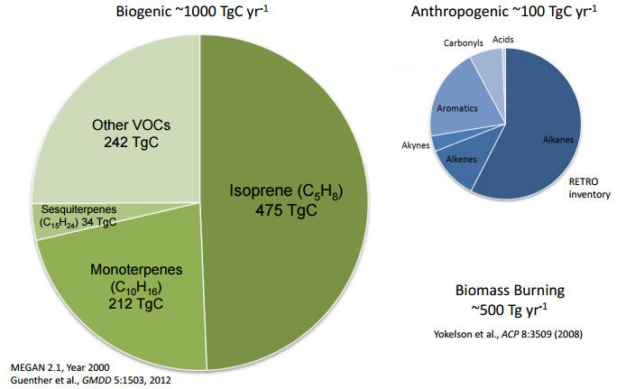
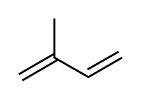
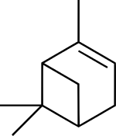
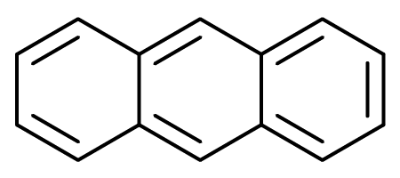
Organic Emissions
VOC’s: Volatile Organic Compounds
Many subclasses including SVOC’s (semivolatile), IVOC’s (intermediate), HOOC’s (highly oxidized), etc..

Slide 13
Inorganic Emissions
NOx
Comes from incomplete combustion
SOx
Comes mostly from coal and sulfuric fuel combustion
ClOx and BrOx
Come from CFC (and brominated chemicals) degradation in the stratosphere

Slide 14
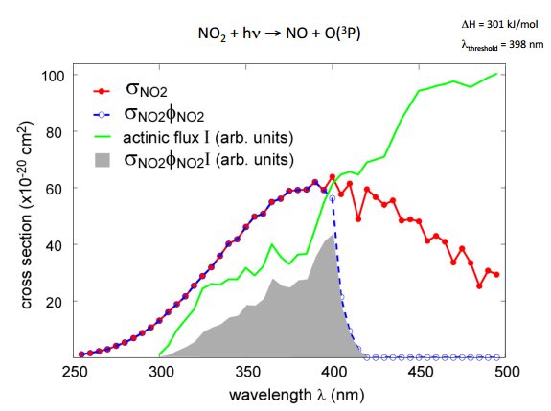
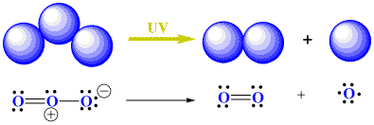
Photolysis
Photolysis: breaking with light
In this course we’ll use it to mean light breaking a chemical bond

Slide 15
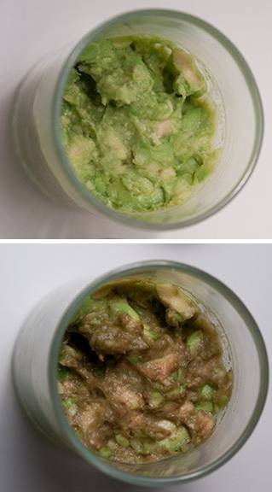
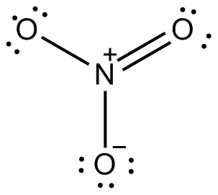
Atmospheric Oxidation
The atmosphere is a highly oxidizing environment
The OH Radical
Oxygen
Other oxidants include ozone, HO₂, and NO₃
NO3 important at night because photolysis destroys it and is necessary to form OH

Slide 16
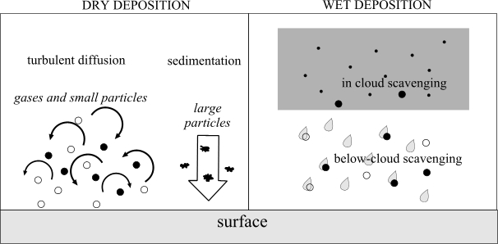
The Fate of Atmospheric Organics
Wet Deposition
Rain and fog scavenge hydrophilic species and rain them out of the atmosphere
Dry Deposition
Atmospheric species deposit onto surfaces
Oxidation to CO₂
CO₂ is the most reduced form of carbon and is difficult to react away

Slide 17
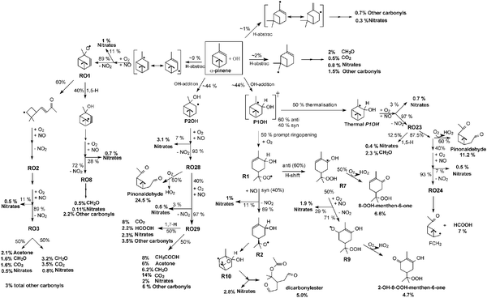
Atmospheric Chemistry is… Complicated

Slide 18
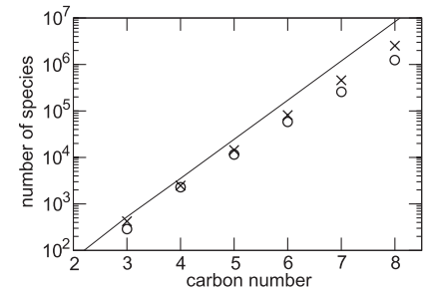
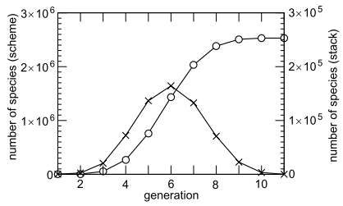
Atmospheric Chemistry is… Complicated
One emitted species can yield millions of oxidation products

Slide 19
Major Catalytic Cycles
Cycles make the world go ‘round

Slide 20
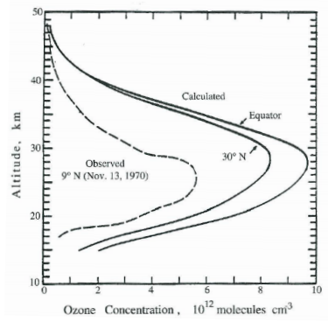
Chapman Chemistry (Stratosphere)
See board notes

Slide 21
No_{x} Cycles (Trop + Strat)
See board notes

Slide 22
Ho_{x} Cycles (Trop + StRAT)
See board notes

Slide 23
Clo_{x} and Bro_{x} Cycles (Stratosphere)
See board notes

Slide 24
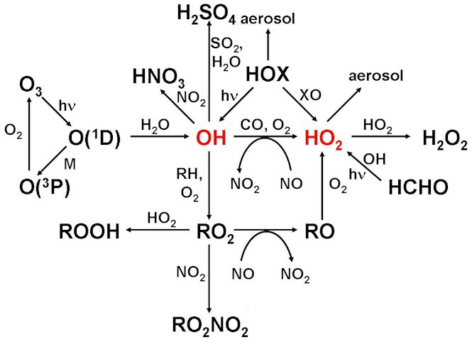
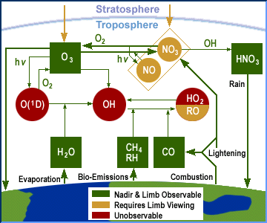
Combined Cycles

Slide 25
The Ozone Hole
I smell a Nobel prize…

Slide 26
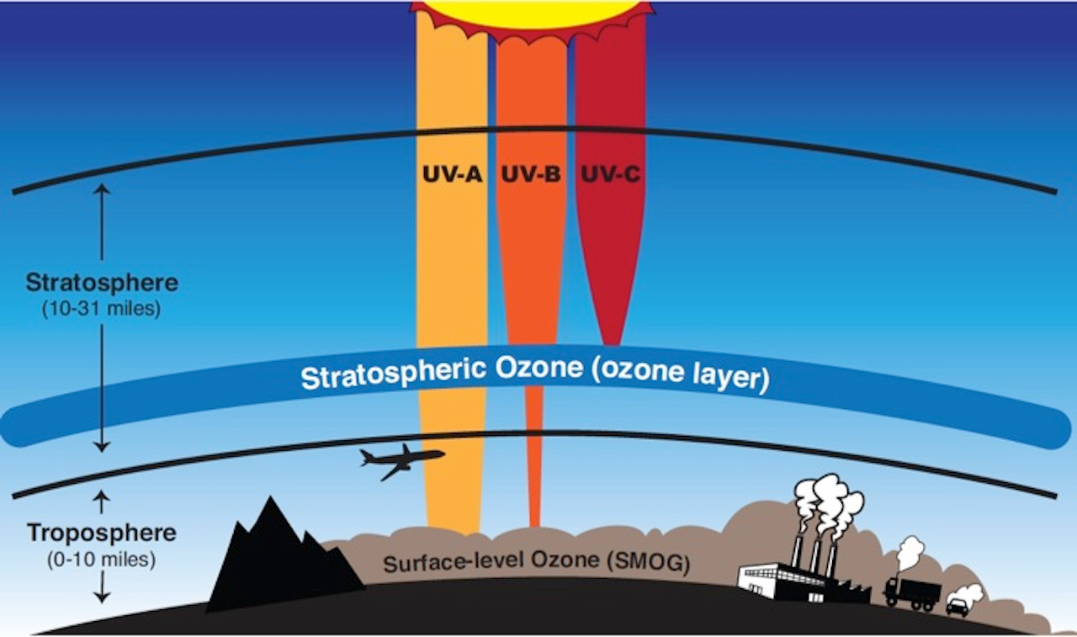
The Ozone Layer
The ozone layer protects the surface from harmful UV radiation
UV radiation can mutate DNA and kill cells
The ozone layer is not just a blanket of ozone, it’s more of a region with a high ozone concentration

Slide 27
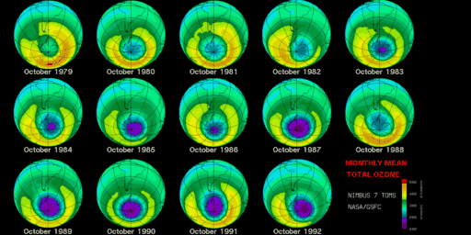
The Ozone Hole
The ozone hole(s) is/are located above the South Pole and sometimes the North Pole.
The poles are the only places cold enough for catalytic ozone destruction.

Slide 28
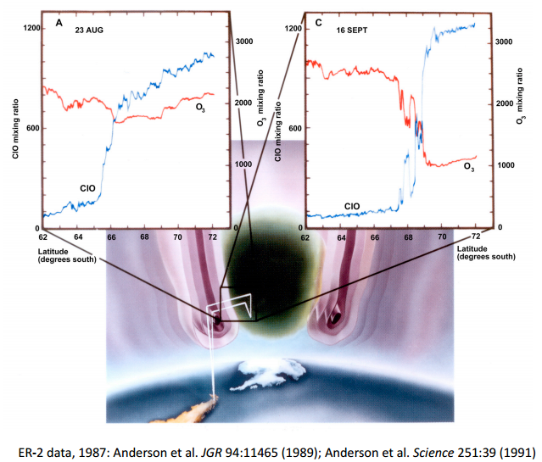
The Polar Vortex
Atmospheric dynamics (aka wind) create a vortex over the poles
This vortex essentially cuts the atmosphere directly over the poles from the rest of the stratosphere

Slide 29
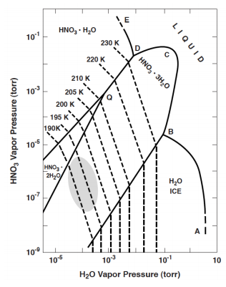
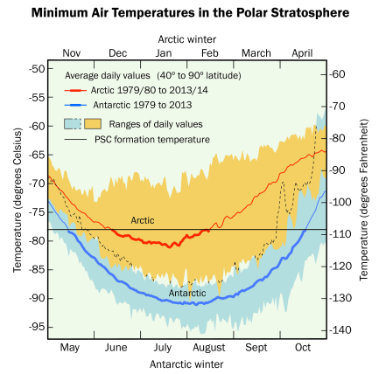
Polar Stratospheric Clouds
Polar stratospheric clouds are made of ice and (usually) nitric and/or sulfuric acid

Slide 30
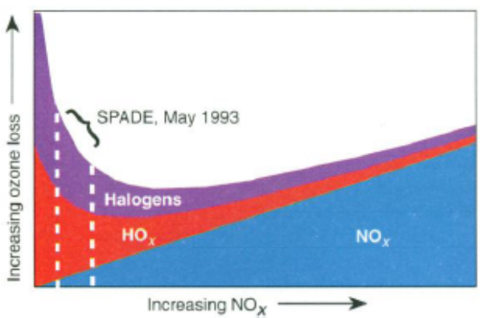
The “de-NOx-ification” of the Stratosphere
PSC’s collect NOx in the form of HNO3 and then settle out of the atmosphere
This increases the importance of other ozone destroying cycles…

Slide 31
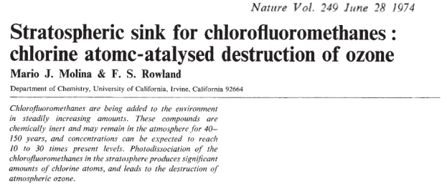
How To Win a Nobel Prize

Slide 32
One More Catalytic Cycle
See board notes

Slide 33
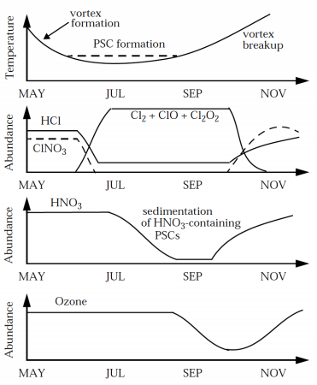
Ozone Hole Formation Timeline

Slide 34
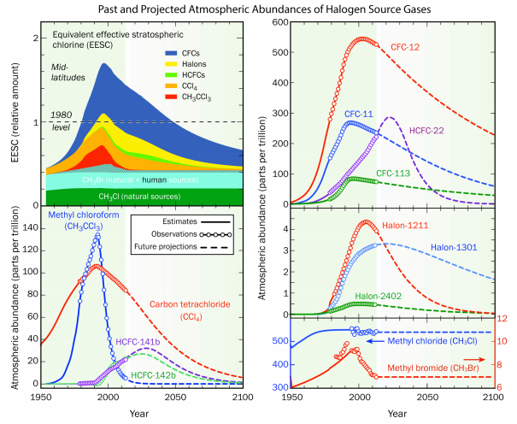
The Montreal Protocol
The Montreal Protocol (1987) and its subsequent amendments are U.N. resolutions designed to phase out CFC, HFC, and HCFC emissions
The first universally ratified treaties in United Nations history
The former Secretary General of the U.N. Kofi Annan quoted as saying that "perhaps the single most successful international agreement to date has been the Montreal Protocol."

Slide 35
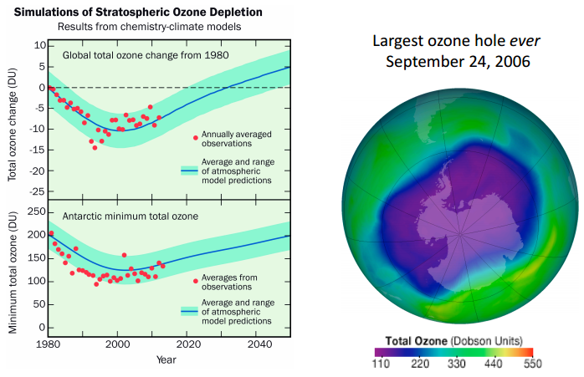
The Hole is Shrinking

Slide 36
“A World Avoided”

Slide 37
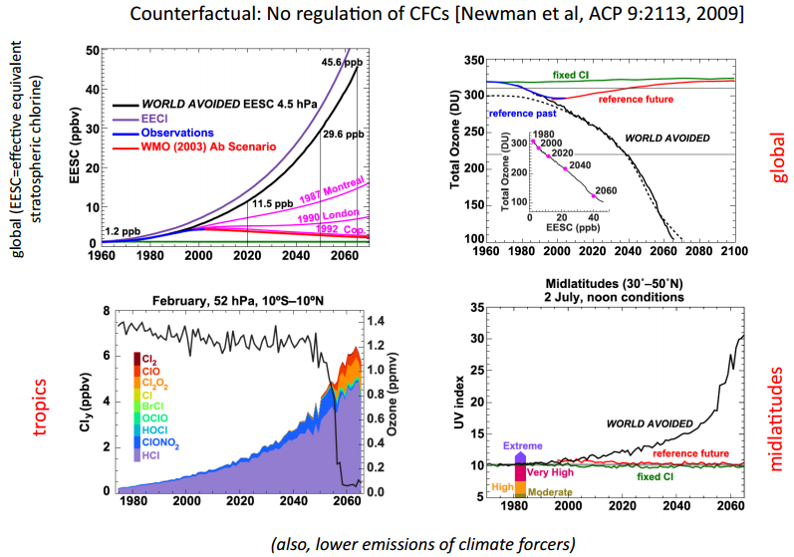
Scientific Prediction Helped avoid disaster

Slide 38
Humans Might Ruin It Again…
Geoengineering might be necessary and would hurt ozone layer
Increasing temperatures?
Increasing tropospheric temperatures decrease stratospheric temperatures
Decreased strat. temperatures increase the probability of PSC’s
More NOx in the stratosphere?
Increased NOx for stratospheric airplanes could further deplete ozone.
Baseline
With Geoengineering
[Rasch et al., 2008]

